Slide 1
Weapon & OME: Safety, Integration & Assurance
Service Portfolio
Trevor Leckie

Slide 2


Contents
Weapons & OME: Safety, Integration & Assurance
Core Services
Project Examples (available upon request)

Slide 3
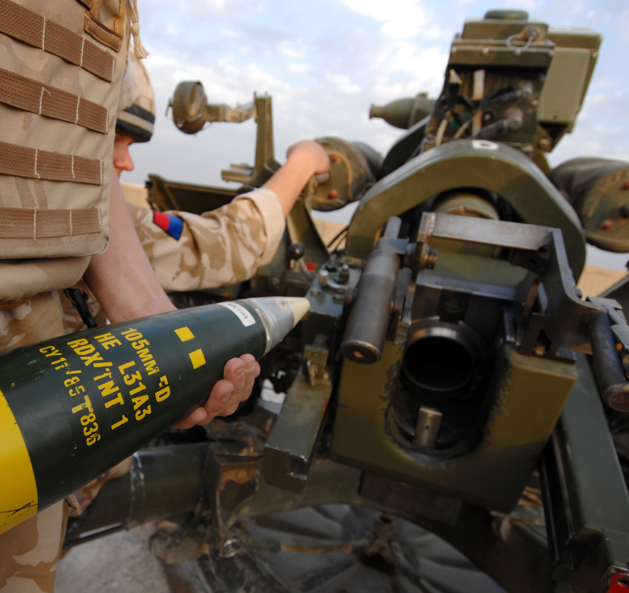
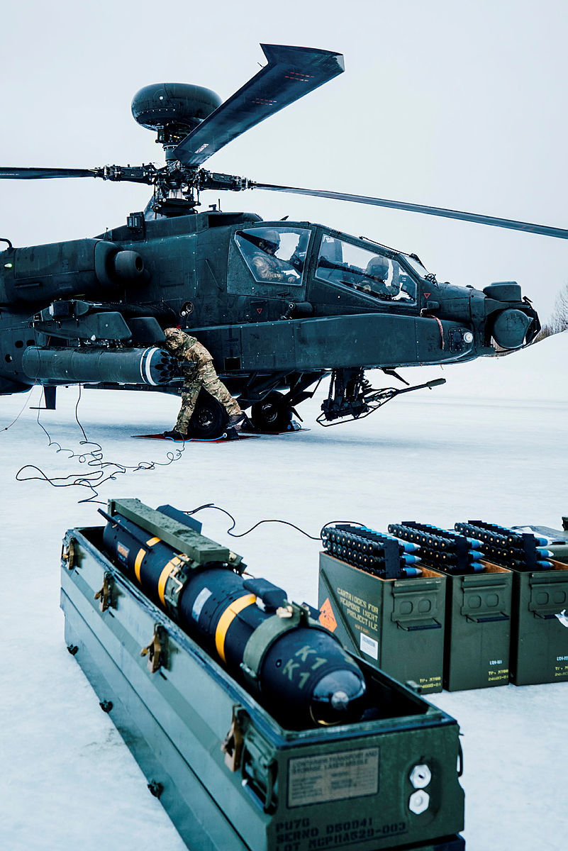
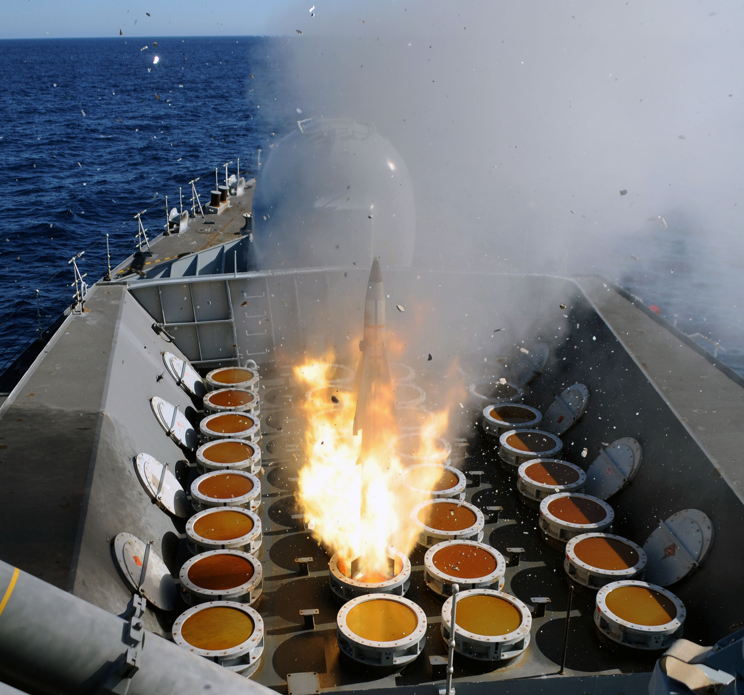
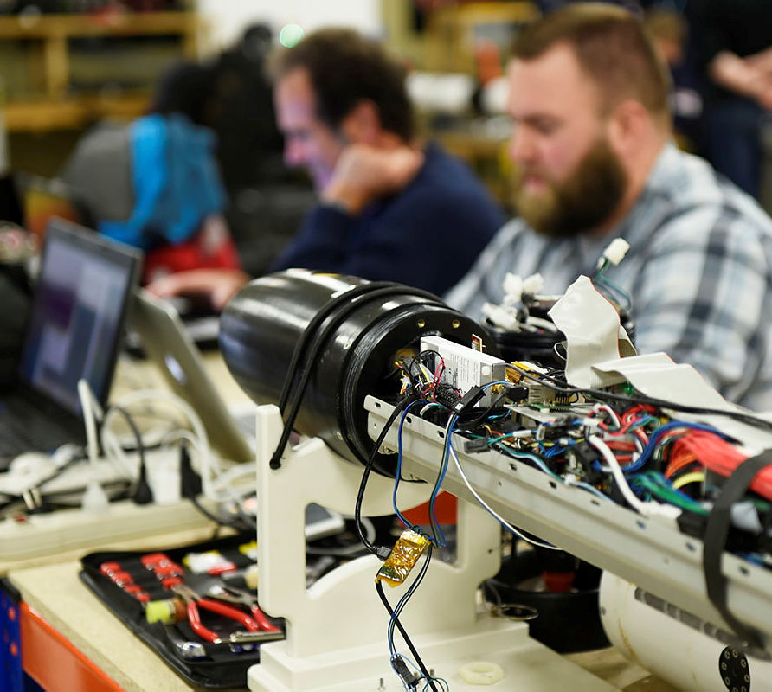

Core Services
OME & Weapons Safety
Platform Integration
Weapons Test & Evaluation
Research & Novel Weapons
Transferable Safety Skills
Providing expert Safety Assurance and Technical Advice
Land, Sea and Air weapon system platform integration and assurance
Improving OME & Weapon safety through effective Test & Evaluation
Conducting weapons related research including Novel Weapons technology
Utilising our transferable skills to support other projects, business sectors & technical domains

Slide 4

OME & Weapons Safety
Ordnance Munitions & Explosives Safety
OME Safety Review Panel (OSRP)
We specialise in assuring the inherent risks from OME are either Broadly Acceptable or Tolerable and As Low as Reasonably Practicable (ALARP) for the UK MOD and industry in the defined service environment.
The assurance regime delivered by Frazer-Nash as OSRP, emphasises the duty of care of UK MOD and the ownership and management of risk by the weapon system operators.
Weapons Safety
Safety Management Systems
Compliance assessment of design requirements for Weapons and Associated Systems and the provision of Safety and Suitability for Service (S3) against UK Defence Standards and US Military Standards.
We help our clients to develop and operate an effective SMS that defines the framework to direct, control and monitor their safety management activities throughout the Manufacture to Target or Disposal Sequence.
Safety Case Development
Safety Risk Management
Frazer-Nash deliver structured arguments, supported by a body of evidence that provides a compelling, comprehensive and valid case that a system is safe for a given application in a given operating environment.
We support clients in managing predicted and emergent Risks to Life arising from hazards and accidents associated with the through life ownership and use of OME & Weapons.
Crown Copyright/MOD
https://www.defenceimagery.mod.uk/

Slide 5
Platform Integration
Land-based System Integration
System of Systems
Adherence to Land System Safety and Environmental Protection Defence Codes of Practice (DCoP) and Regulations ensuring safe integration of all weapons & OME fitted or carried as stores.
Helping clients to record safety information sets necessary to enable integration or interoperation with other Products, Services and Systems including integration into a complex System of Systems.
Sea-based System Integration
Training & Maintenance
Compliance with Defence Maritime
Regulations for Health, Safety and Environmental Protection. The outputs allow Naval Authority Explosives to certify OME integration into the ship platform.
Ensuring systems are acceptably safe in training and suitably maintained during peacetime and on operations to remain safe and Suitable for Service (S3) and stay within their defined safe operating envelope.
Air-based System Integration
Operational Support
Assessment of the carriage, launch and jettison of Air Launched Weapons (ALW) from aircraft in accordance with the Military Airworthiness Authority Regulatory Procedures (MRP).
Ensuring the Duty Holders demonstrate compliance with their statutory duties and standards for safe storage, handling, processing, transportation and disposal and remain compliant through life.
Crown Copyright/MOD
https://www.defenceimagery.mod.uk/

Slide 6
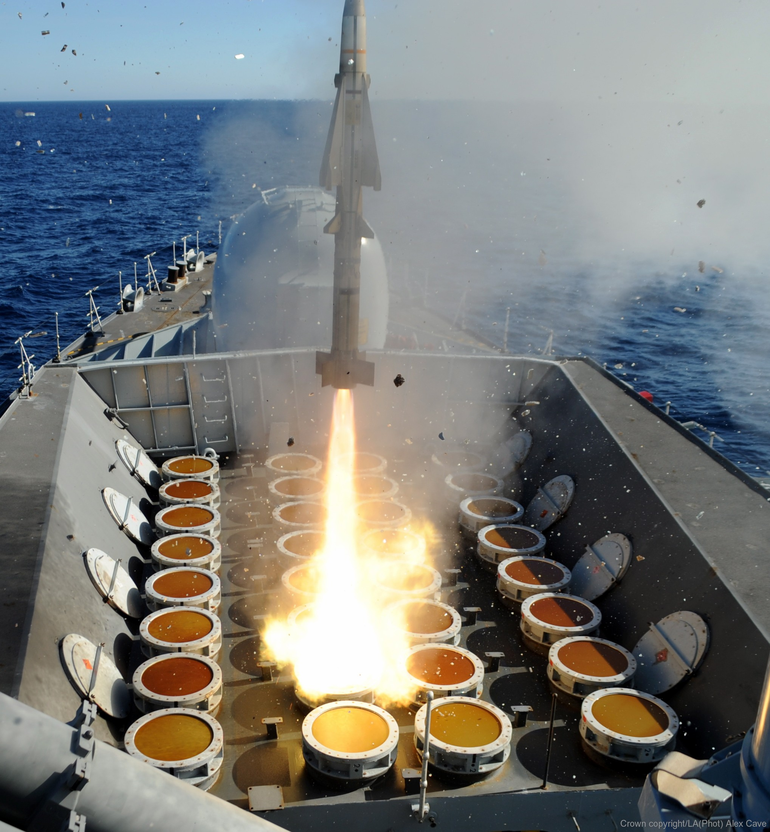
Weapons Test & Evaluation
De-risk Live Trials
Assessment of Results
Support in the development and/or review of an appropriate qualification plan to recognised standards to minimise trials cost, time and risk.
The assessment of trials and tests results and/or the technical reporting of the results including recommendations on lifing and limitations of use for Weapons and OME through life.
Trials Requirements
Insensitive Munitions Compliance
Supporting clients with the development of their trials and tests requirements including identifying a suitable trials site, writing Trials Plans and Specifications including the definition of the pass / fail criteria.
Assessing IM risks and evaluating IM specific test results. MOD Policy requires the vulnerability of munitions in the MOD inventory to be reduced over time to meet the requirements of STANAG 4439.
Trials Optimisation
In-Service Surveillance
Development and/or review of detailed trials methodology and parameters to ensure they reflect the desired service life in the agreed Predicted Service Environment (PSE) of the host platform(s).
Developing ISS plans to ensure Life Assessment continues throughout the service life of the Weapon System to inform engineering decisions regarding Life Extension.
https://www.seaforces.org/wpnsys/SURFACE/Sea-Wolf-SAM.htm Crown Copyright/MOD

Slide 7
Research & Novel Weapons
Defence Science Technology Laboratory
Directed Energy Weapons
We have an enduring working relationship with DSTL via several commercial tasking frameworks including Analysis for Science and Technology Research In Defence (ASTRID), R-Cloud & Serapas.
The UK MOD has awarded £72.5m to UK industry consortia for delivery of DEW Capability Demonstrators. Frazer-Nash currently support the Raytheon UK DEW programme.
High Speed Weapons (HSW) and Hypersonics
Cost Effective Disposal
HSW & Hypersonics are of strategic importance to MOD’s international partners and is one of the Next Generation Capability Cooperation pathfinders (NGCC) in the newly established AUKUS agreement.
Research into how the UK Government and other NATO nations, can improve weapon disposal practices to help achieve its Net Zero 2050 targets and demonstrate compliance with regulation.
Weapons Sector Research Framework
FNGUN
Frazer-Nash is part of the UK MOD WSRF which allows us to collaborate with UK industry and leverage multi-domain experience of UK suppliers on a range of MOD funded weapons research tasks.
The FNGUN is an internal ballistics analysis software suite developed and supplied by Frazer-Nash with tailored on-site training, technical support and a library of typical gun system components and examples.
Crown Copyright/MOD
https://www.defenceimagery.mod.uk/

Slide 8
Transferable Safety Skills
Space
Testing Novel Technologies
We have provided safety support to Reaction Engines Limited (REL) Hot Heat Exchanger (HTX) and Ground Support Equipment (GSE) test programme. We are developing other opportunities within the UK Space Program.
Frazer-Nash lead the Future Labs research work package to investigate the physical assets and infrastructure required for the successful testing of directed energy and hypersonic systems.
Artificial Intelligence & Autonomous Systems
Synthetic Environments & Digital Twins
We are developing our capabilities within AI systems assurance and trustworthiness of autonomous systems. A fast growth area within defence which has wide industrial applications across multiple business sectors.
Investigating the use of Synthetic Environments & Digital Twins for Test & Evaluation within the Weapons Qualification Improvement Programme (WQIP) to reduce reliance on live trials.
Robotics
Qualified Lead Auditors
We have experience of robotic platforms for nuclear decommissioning, bomb disposal and logistics re-supply. We are currently seeking opportunities within the Space sector and the application of drone technology.
We have a highly qualified team of Safety Lead Auditors (ISO 9001:2008) performing Independent Safety Auditor (ISA) and Contractor Safety Auditor (CSA) roles for a wide range of clients.
https://www.fnc.co.uk/what-we-do/your-industry/defence/weapons-ordnance-munitions-and-explosives/weapon-simulation-and-modelling/

Slide 9
Project Examples
Weapons Simulation & Modelling
The Weapons Assurance Team also works closely with the other Frazer-Nash departments to solve complex engineering problems for our clients. This includes the Simulation & Modelling team. Further information can be provided upon request.
Weapons Assurance Project Examples
Some project examples include:
Ground Based Air Defence (GBAD)
Trophy Active Protection System (APS)
Weapons Operating Centre Independent Safety & Environmental Auditor
Tomahawk Land Attack Missile (TLAM)
Harpoon Weapon System
WOME Disposal
Laser Directed Energy Weapon (LDEW)
Further details or these and numerous other project examples can be provided upon request.
Environmental Assurance
Safety risk assessment and assurance is often undertaken alongside Environmental assurance. Frazer-Nash also has a dedicated Environmental Management team. Further information can be provided upon request.

Slide 10
Thank You
Trevor Leckie
Weapons Assurance Group Leader
t.Leckie@fnc.co.uk
+44 1179378417

